Slide 1
Performance Testing of Deep Learning and Auto-Segmentation Algorithms
Alex Kolby
Eskild H. Andersen
Simon Rydder

Slide 2
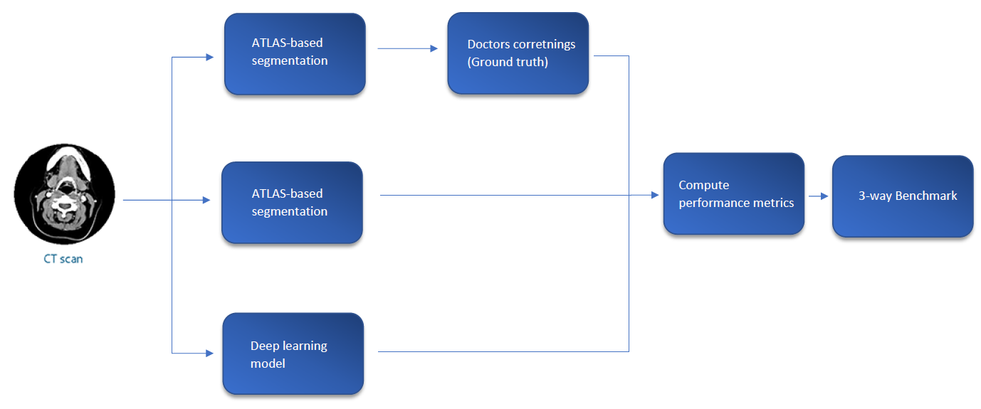
Problem description
Investigate the difference in performance of autosegmentation algorithms for delineation of organs.
Create a good performance measurement for benchmarking.

Slide 3
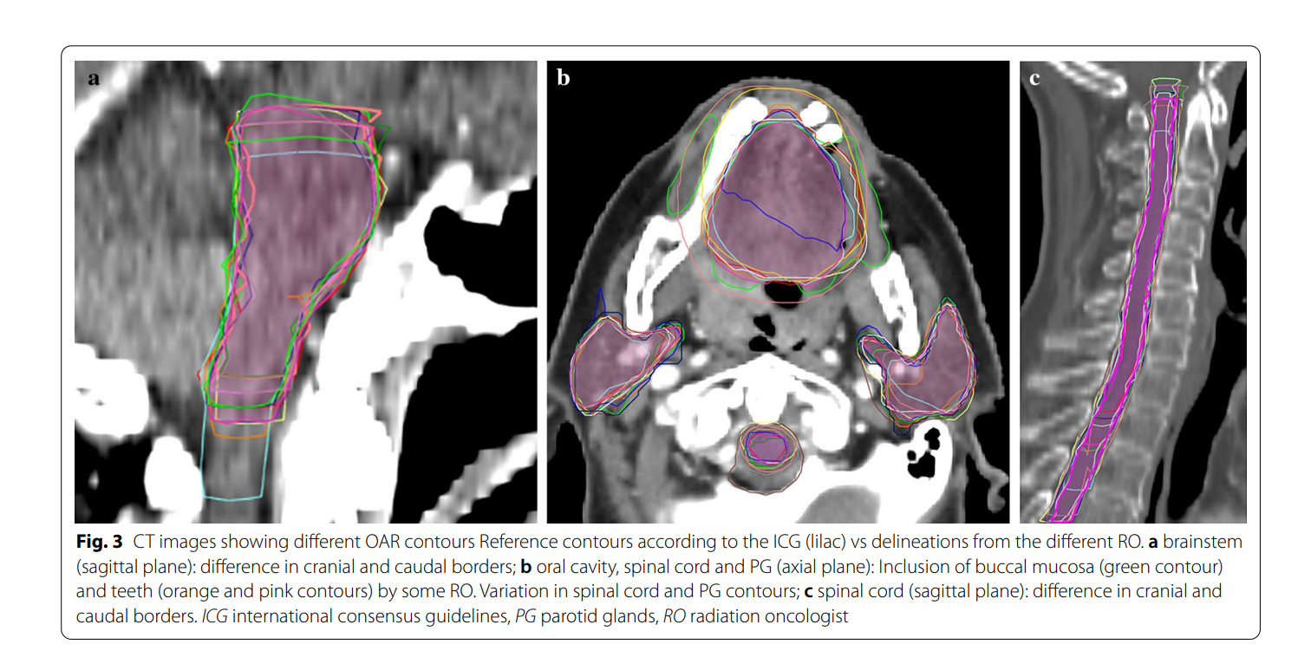
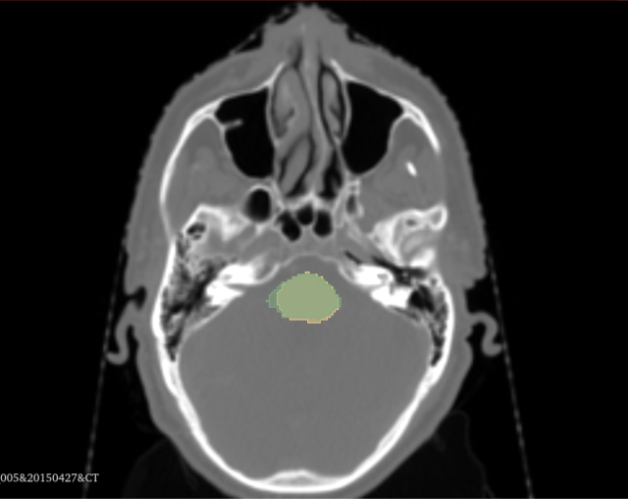
The data
Database consisting of approx 800 patients treated for cancer at Aarhus Universitetshospital in the period 2005-2016
Data consists of CT scans and the delineation of organs for each patient.
Semi 3D pictures. Consist of slices varying from 2-3 mm. Put together in a stack they imitate a 3D picture.

Slide 4
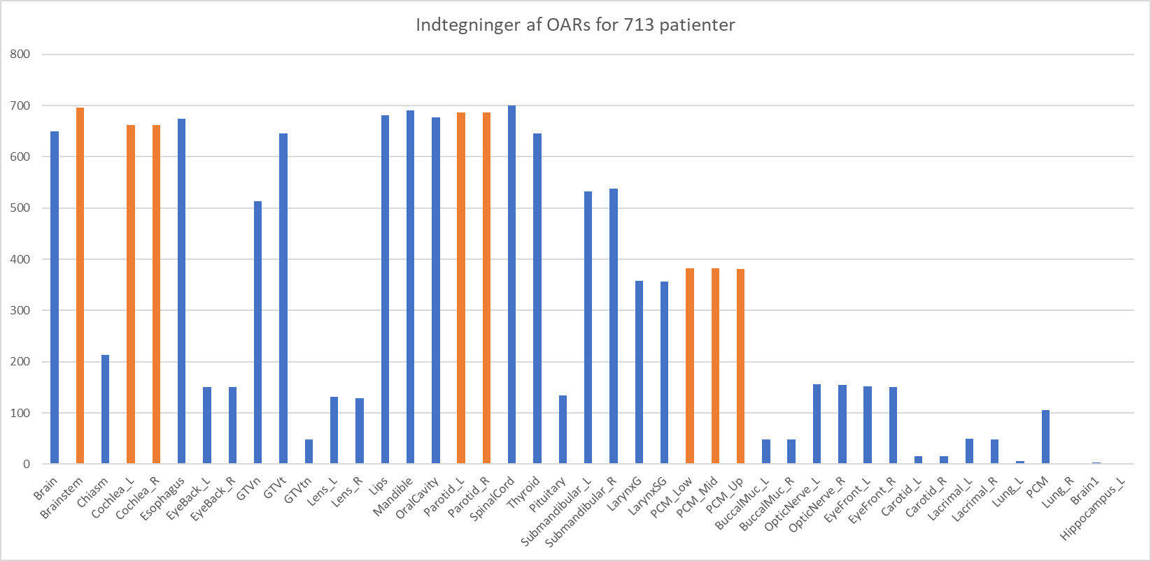

Slide 5
What's next?
Short run
Long run
Data processing/cleaning
E.g designing classes for data handling
Understanding volume comparison measures
DICE, Hausdorff, Mean Surface Distance, Added Path Length
Design benchmarking tools
Benchmarking performance
Visualization of results
Similarity plots
Organ delineation heatmaps
Writing a scientific paper

